Slide 1

Manual Testing Project On InFlow Inventory
Module Name : Inventory
Mentor Pratiksha Mam
Sucheta Kadupatil (TL)
And
Harshal Shelke (TM)

Slide 2
Inflow Inventory is a software application that helps businesses manage inventory , orders , and sales. It has a mobile app that allows users to manage inventory and orders from anywhere.
Features of InFlow Inventory Application
Inventory Management
Order and Sales management
Suppliers and Customer Management

Slide 3
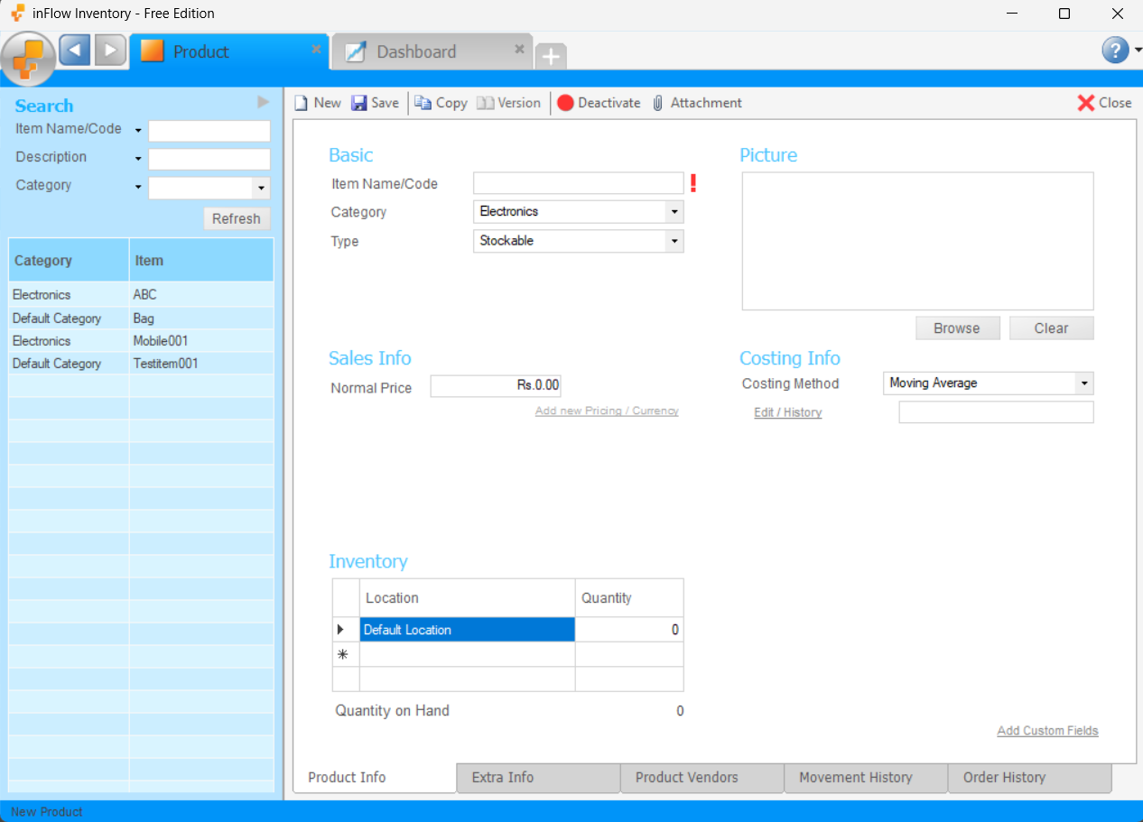
Roles and Responsibilities
Inventory Module Testing
Functions of Inventory Module
Basic Item Name/Code
Category
Type
Picture
Sales info – Normal price
Costing info – Costing Method
Inventory – Location
Inventory - Quantity

Slide 4
Buttons
Toolbar
New
Save
Copy
Version
Deactivate
Attachment

Slide 5

Teammate Name: Sucheta (TL) & Harshal (TM)
This functions Done by Sucheta
Picture
Sales-Info : Normal Price
Costing-Info : Costing Method
Inventory : Location
Inventory : Quantity
Button : New
Button : Save
This functions Done by Harshal
Item Name/Code
Category
Type
Button :Deactivate
Button : Attachment

Slide 6
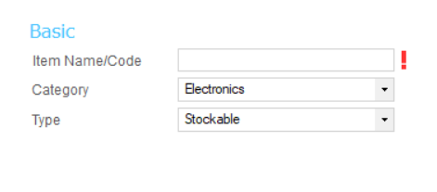
Functions
Basic Section
Item Name/Code : The name or item code for this product. No two products or services can have the same Item Name/Code.
Category : The product category in which you put this product. Add New brings up new Category tab which can be named and saved.
Type : The type of product; Stockable Product, Non-Stockable Product or Service. This is set when the product is created but it can be changed later. The default value is Stockable.

Slide 7
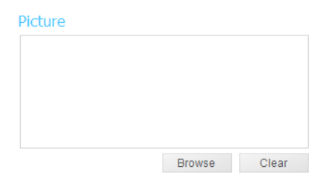
Picture
You can add a picture of your product right into the product information. To do this, click the Browse button and then select a picture of the product. The common picture formats supported are JPG and PNG. To clear an existing picture from your product information, click the Clear button.

Slide 8
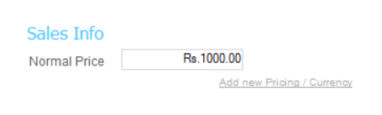
Sales Info
Normal Price
You may have one or more pricing fields here depending on the pricing schemes you have defined in Company Settings. You can enter the price you normally charge under those pricing schemes here. If you’re using different units of measure, the price should be for one unit of the sales unit of measure. If the product Cost is filled in, then the Markup will automatically be calculated and shown. You can either type in the price directly or type in the desired markup and inFlow will set the appropriate price to match the markup over this products costs. Keep in mind that pricing schemes are currency specific so if you’re setting up a Retail scheme for two currencies, you'll have to set up two schemes (one for each currency)

Slide 9
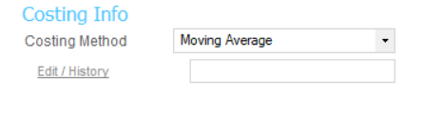
Costing Info
Costing Method
The method used to keep track of the unit cost of this product. This defaults to Moving Average Cost for Stockable Products and Last Purchase for Non-Stockable Products and Services. If you select Moving Average as the Costing Method, you can view history or edit it by clicking the Edit/History link. Last Purchase Cost is not editable. it is automatically set when a post order is completed and includes shipping costs. For the Manual method, you can enter any cost. You may choose to take various factors into consideration, like purchase, shipping, storage, and tooling costs in addition to purchase costs.

Slide 10
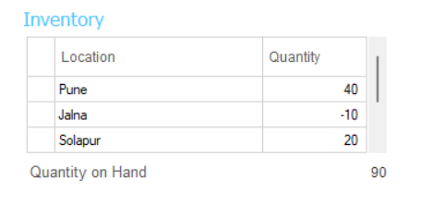
Inventory
Location : This column contains the locations for this product. This includes the default location and many other locations can be added.
Quantity : This is the quantity of the product at that location.
Quantity on Hand : This is the total quantity of a product that you have in your inventory storage.

Slide 11
Toolbar
New : Creates a new Product. If you have another Order open, the system will prompt you for saving changes to that Order.
Save : Saves the changes to the Order. The system will save the Order with an automatically generated Order
Copy : Creates a copy of the old product with all the appropriate fields copied.
Version : Click to look at older versions of this Product. Old versions are saved correctly and are read-only.
Deactivate : Click on deactivate it will hide your Product.
Attachment : Click to add attachment files to this Product. This opens a pop-up dialogue box to add new attachments and save them. Attachments can be saved, deleted or opened properly.

Slide 12
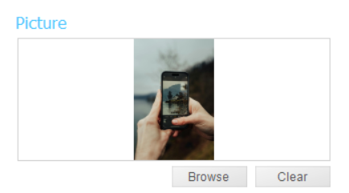
Defect Report Inflow-inventory application: Inventory Module
Function : Picture
Scenario : Large file size cannot be uploaded
Test Case ID : TC_013
Severity : Critical
Priority : Urgent
Image size is 13MB

Slide 13
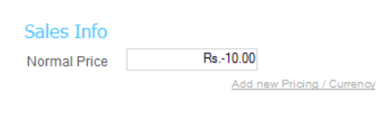
Function : Sales info-Normal Price
Scenario : Negative values are not allowed in the price field.
Test Case ID : TC_017
Severity : Critical
Priority : Urgent
Negative Value (-10)

Slide 14
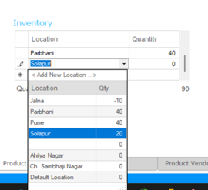
Function : Inventory-Location
Scenario : Location name cannot contain only spaces.
Test Case ID : TC_025
Severity : Non-Critical
Priority : Low
(space)

Slide 15
Challenges
I faced some challenges while working on this project. Initially, I had difficulty downloading the application due to certain issues, but after some time, I was able to install it successfully. After that, I took some time to understand the test scenarios, which seemed complex at first. However, with patience and practice, I was able to grasp them clearly. I learned a lot and gained valuable experience throughout the process.

Slide 16
Experience
After completing the Inflow Inventory project, I have gained valuable experience in software testing
Understanding how the Inflow Inventory system functions.
Gaining hands-on experience in testing different scenarios to ensure system reliability.
Identifying and resolving system bugs/defects efficiently.
Developing the ability to write detailed test reports.
Enhancing problem-solving skills through real-world testing challenges.
Improving collaboration and communication by working on project documentation and reporting.
This project has significantly contributed to my knowledge of manual testing and helped me develop a structured approach to software quality assurance.

Slide 18
Thank You
I would like to express my heartfelt gratitude to everyone who supported me throughout this project. Special thanks to my Teammate Harshal, My Mentor Pratiksha mam, and my friends Tisha ,Samarth and Sahil for their valuable guidance and encouragement. Your support has been invaluable in making this project a success.
A big thank you to all for your time, support, and
patience in listening to my presentation.

